Slide 1
Flip-Flop Smart Shoe
By: Akshaj, Angy, Jakub, Josh

Slide 2
Intro
This project consists of a bluetooth wearable device which our group decided to call the “Flip-Flop”. What it does, is gather data on how a person walks and analyzes it.
A common issue in today’s world is many people walk by the method out-toeing and don’t even realize it. This wearable device is here to help with that.
Since every individual walks differently, and produces different data sets we constructed our device to mitigate this issue. By collecting a diverse sample, this device paired with code can diagnose the users gait, whether that's out-toeing, in-toeing, or other types of gaits.

Slide 3
Purpose
What's the point of this project?
To gather Gait data and analyze it on a particular person walking. Normal Gait is the safe way that most of the population should be walking. Sadly this is not the case.
Create self-awareness of the issue to the population.
Possibly prevent a number of people in the population from various joint and cartilage issues in the hips and knees.

Slide 4
Demo-Time Introducing Wearability
Considered different sizes by making adjustable straps.
Easy to wear and comfortable with foot padding and stretchy elastic material.
Safety of individual considered by covering electronics so there is no direct skin contact.

Slide 5
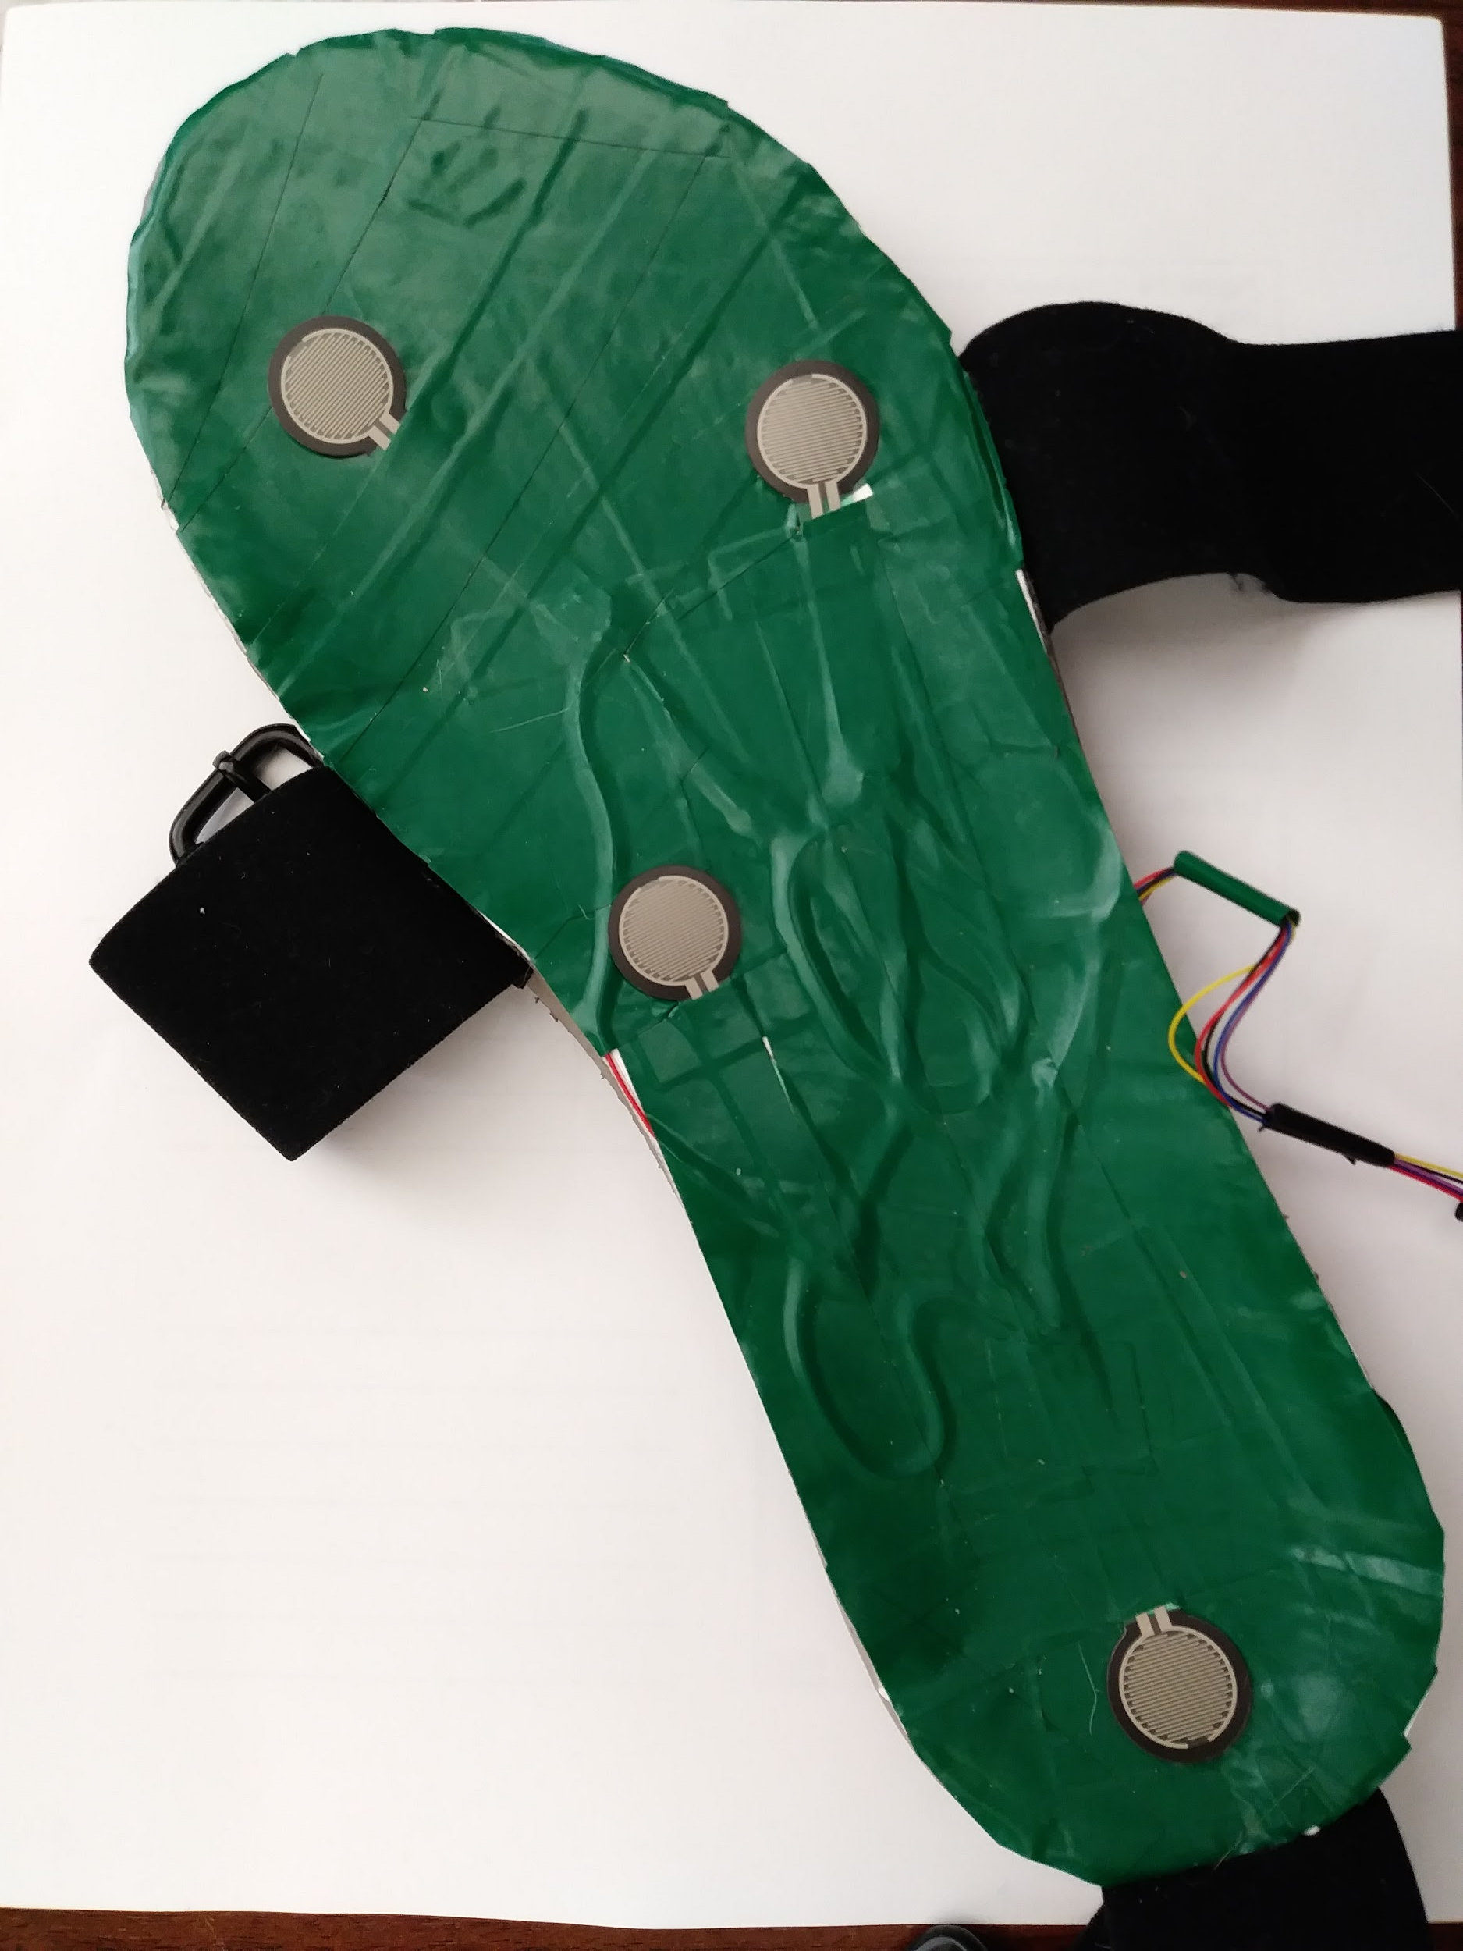
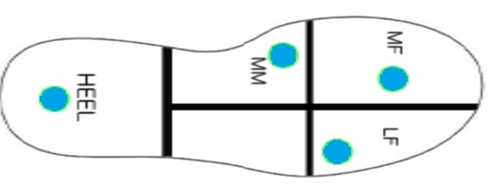
Design Sensors
Placed 4 Force Sensitive Resistor sensors at the Medial Forefoot (MF), the Lateral Mid-foot (LF), the Medial Mid-foot (MM), and Heel.

Slide 6
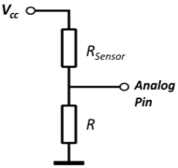
Design Wiring
The output of sensor is connected to the input of analog pin and also we connect each FSR sensor to a 3.6 KOhm resistor in series to see relative change in the force exerted on each FSR sensor in respect to the other 3 FSR sensors.

Slide 7
Design LED’s
The Arduino is setup to read voltage from the sensors and each LED is mapped to the input from the respective FSR sensor, such that the brightness of LED is directly proportional to the force applied.

Slide 8
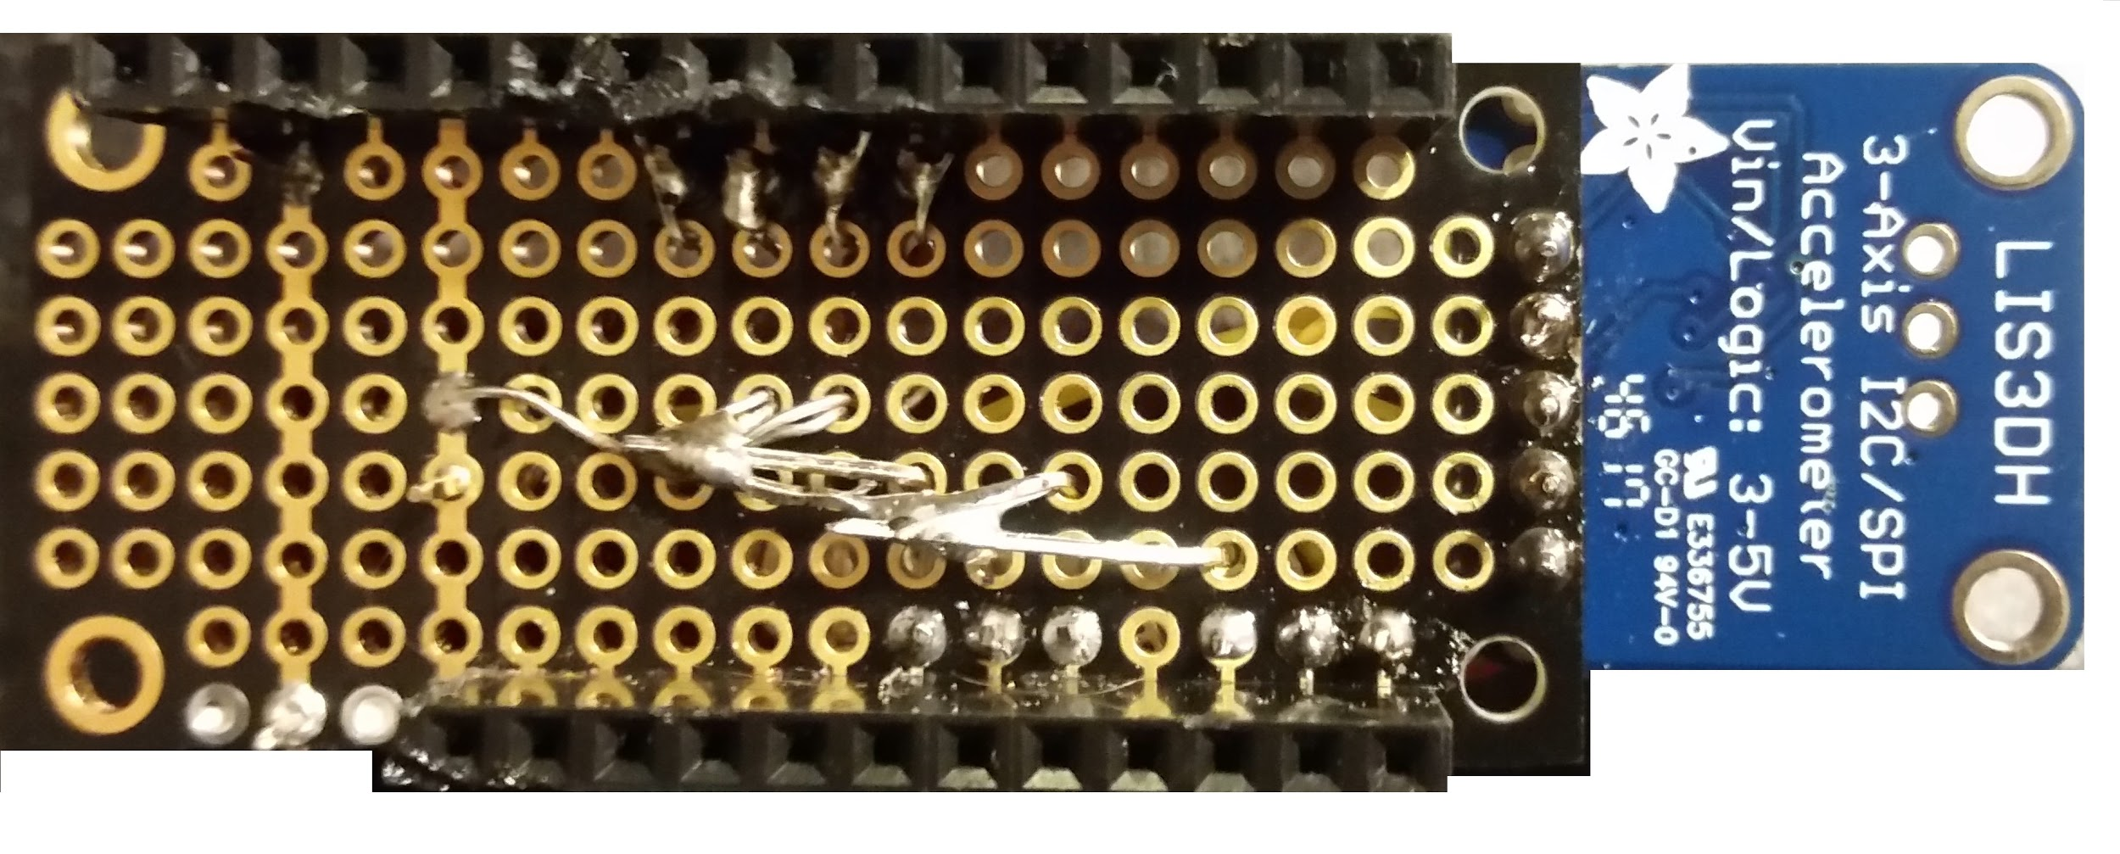
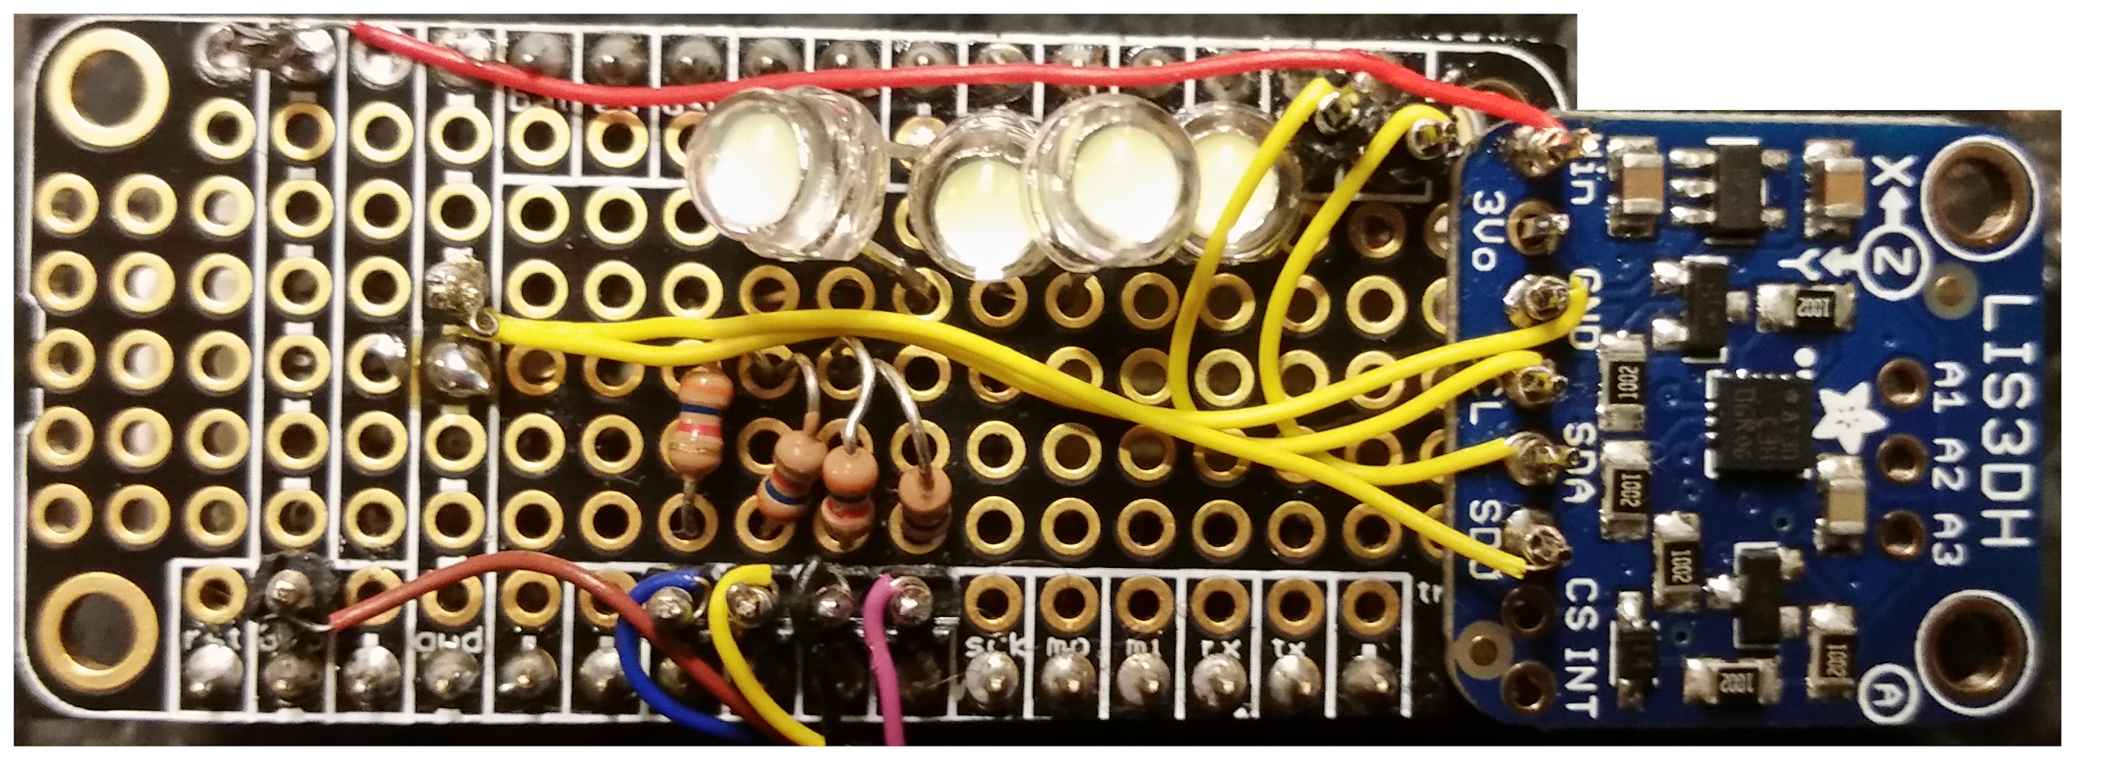
Design Accelerometer
Accelerometer is connected to the arduino to obtain position of the device and acceleration in all directions.

Slide 9
Normal Gait Data
Data: average LF: 424.96 average MM: 278.02 average MF: 453.99 average HEEL: 339.0 average MFP: 59.61 total steps: 46
Cadence: 102.22 steps/min Speed: 0.649 m/s Stride Length: .762 m Step Length: .381 m

Slide 10
Heel Data
Data: average LF: 66.14 average MM: 4.42 average MF: 204.74 average HEEL: 707.82 average MFP: 23.57 total steps: 46 Cadence: 93.878 steps/min Speed: 0.596 m/s

Slide 11
Tip Toe Data
Data: average LF: 456.59 average MM: 3.42 average MF: 613.46 average HEEL: 0.43 average MFP: 64.86 total steps: 44 Cadence: 94.964 steps/min Speed: 0.603 m/s

Slide 12
In Toe Data
Data: average LF: 431.16 average MM: 321.94 average MF: 399.67 average HEEL: 379.5 average MFP: 57.23 total steps: 40 Cadence: 90.225 steps/min Speed: 0.572 m/s

Slide 13
Out Toe Data
Data: average LF: 387.08 average MM: 314.13 average MF: 473.99 average HEEL: 378.37 average MFP: 61.56 total steps: 40 Cadence: 96.774 steps/min Speed: 0.614 m/s

Slide 14
Akshaj’s User Data
Data: average LF: 538.35 average MM: 387.19 average MF: 473.42 average HEEL: 385.47 average MFP: 41.32 total steps: 94 Cadence: 95.270 steps/min Speed: 0.605 m/s

Slide 15
Josh’s User data
Data:
average LF: 456.42
average MM: 342.46
average MF: 429.97
average HEEL: 355.86
average MFP: 54.63
total steps: 126
Cadence: 106.178 steps/min
Speed: 0.674 m/s

Slide 16
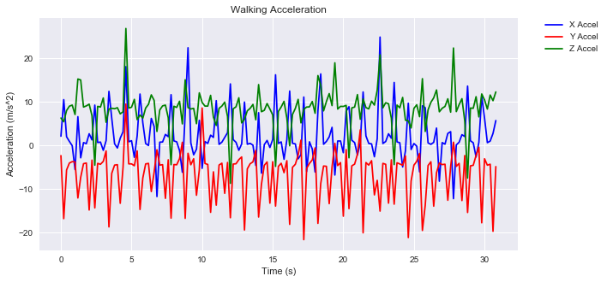
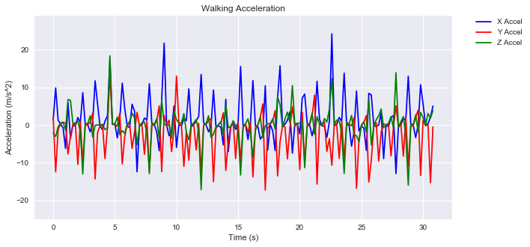
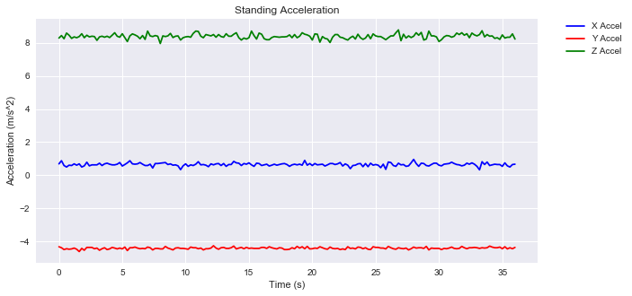
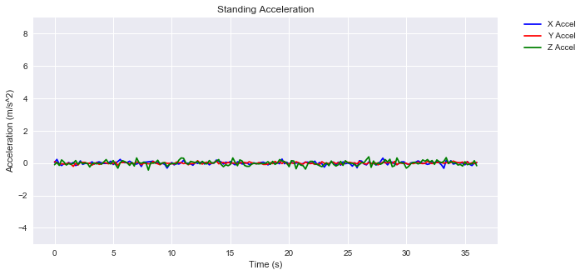
Acceleration Data
Raw Data
Eliminating Gravity component

Slide 17
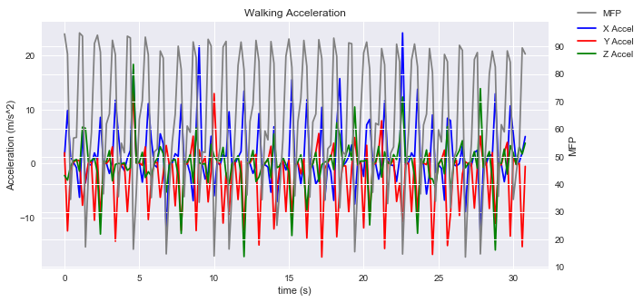
Acceleration Data Cont.
Code: plt.xlabel('Time (s)') if stdX<1 and stdY<1 and stdZ<1: plt.title('Standing Acceleration') Else: plt.title('Walking Acceleration')
Tried to to Vi=Vo+a*t in a for loop to “integrate” the acceleration data
Inability to completely isolate components of acceleration
Gravity
Angular Acceleration
Linear Acceleration
Notes:
To find velocity I tried to to Vi=Vo+a*t in a for loop to “integrate” the acceleration data but I believe that I could not fully eliminate the gravity component of acceleration because of the change of orientation of the accelerometer. Also I wasn’t sure how to also get isolate linear acceleration to find the linear velocity from angular acceleration that would also be found in the accelerometer data.

Slide 18
Drawbacks
Could improve data collection code to include step counter, and calculate MFP live, as well as speed and attach that to the printed matrix.
Increase amount of samples taken to have more diverse data profiles for different gaits.
GUI could include an animation of the foot and which parts were active.
GUI could have incorporated analysis and displayed the results.
Prototype was used for data before device was finished. Therefore, could be a degree of error in new data collection with code.
Would improve soldering so that wires are internal to the device.

Slide 19
Conclusion
We hope this project:
Helps monitor a person's walk.
Bring self-awareness to the population.
Help people learn how to improve their walk.
Prevents future problems such as joint and cartilage issues in the hips and knees.
Avoid rare cases such as spinal cord threatening situations as well as possible disk degeneration.

Slide 20
Thank You

